Slide 1

Test Automation Bootcamp: From Zero to Hero

Slide 2
1. Testing Overview

Slide 3
2. Automation Testing

Slide 4
What is Automation Test?

Slide 5
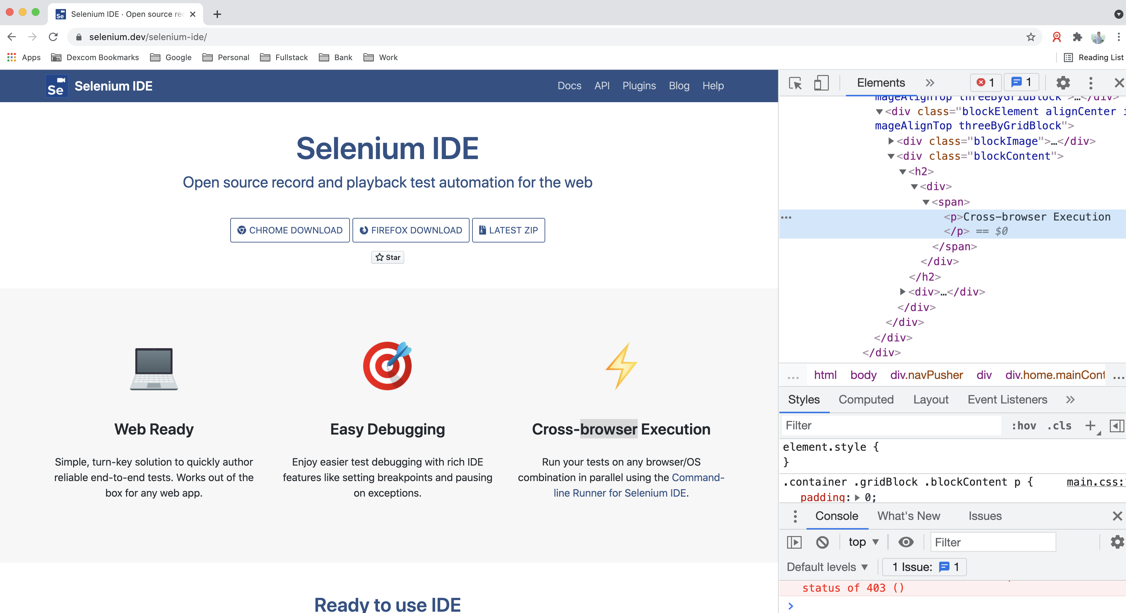
What is Automation Test?
Automation Test
Test automation is many things, we will define test automation as the automatic execution of functional tests, designed at least in some ways to simulate a human being executing manual tests.

Slide 6
Advantages and disadvantages of Automation Test?
Advantages
Performing some tests that cannot be performed at all (or easily) manually
Reducing the time needed for test execution
Increasing the frequency that some tests can be run
Reducing mistakes made by bored or distracted manual testers
Executing tests outside of normal business hours
Increasing confidence in the build
Disadvantages
Delays, costs, and mistakes associated with testers as they learn new technologies
In worst cases, complexity may become overwhelming
Considerable maintenance of tools, environments, and test assets required
The pesticide paradox is increased when automation is used since exactly the same test is run each time
Without clever programming in the automated tests, tools are literal minded and stupid;testers are not

Slide 7
3. Selenium

Slide 8
4. Web Automation

Slide 9
5. Verifications and Assertions

Slide 10
6. Appium

